Slide 1
Average Track Length in Minutes
As we can see, on average, Metal tracks are longer than any other Genre of music at 5.16 minutes. The shortest tracks on average were Rock and Roll.

Slide 2
Most Popular Albums By Country
We see that in the United States The Office Season 3 was the most popular seller. In Canada Arquivo II is the most popular.

Slide 3
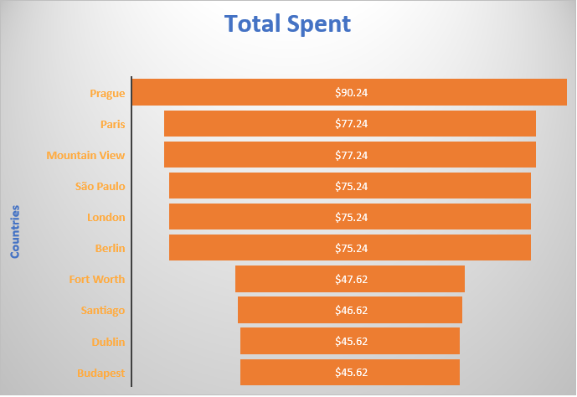
Top 10 Spending Cities
We see that at $90.24, Prague is the top spending city and rounding out the top 10 is Budapest at $45.62.

Slide 4
Top 10 Genres
The top Genre is Rock at 835! More than double the next top Genre which is Latin (386)

